Slide 1
ANATOMY II (ANT 106)
ORTHOPAEDIC AND TRAUMA MEDICINE
YEAR 1
SEM II

Slide 2
A.BONES OF THE UPPER EXTREMITY AND SHOULDER GIRDLE
The upper extremities consists of 64 bones(each upper limb has 32 bones)
These are;
10 bones of shoulder and upper arm
16 wrist bones and 38 handbones
10 bones of the shoulder and upper arm
Each side of the upper extremity
1 Clavicle
1 Scapula
1 humerus

Slide 3
1 Radius and ulna
Shoulder girdle
Is formed by 2 bones
The clavicle (collar bone)
Long bone with double curve
Its is S-shaped
Medial end articulate with manibrium of the sternum to form sternoclavicular joint
Lateral end articulates with acromion process of scapula to form acromioclavicular joint
Provides a bony link between upper limb and axial skeleton

Slide 4
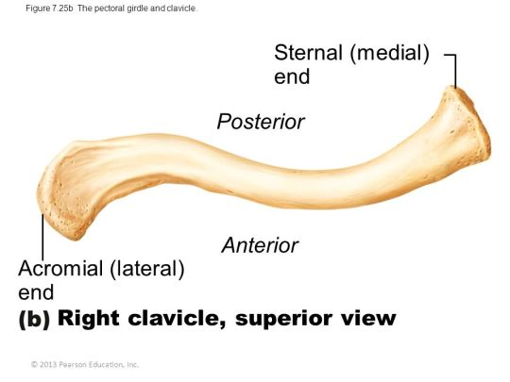

Slide 5
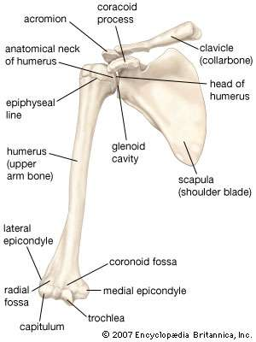
2l

Slide 6
b) Scapula (shoulder blade)
Flat and triangular shaped bow like bone
Lies on posterior chest wall superficial to ribs and separated from them by muscles
Forms shoulder joint where humerus meet the glenoid cavity of the scapula
Posteriorly a spinous process, the acromion process articulates with clavicle to form acromioclavicular joint
A coracoid process a projection from upper borders gives attachment to muscles that move shoulder joint

Slide 7
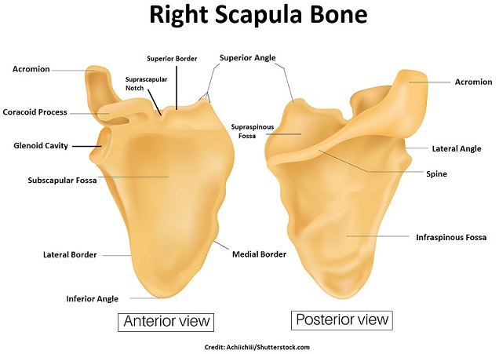

Slide 8
Upper extremities
The humerus
is an upper arm bone
Head articulates with glenoid cavity to form shoulder joint
Distal to the head are 2 roughed surfaces, the greater and lesser tubercles and between them is bicipital groove or intertrabecular sulcus occupied by one of the tendons of biceps
Distal ends articulates with radius and ulna

Slide 9
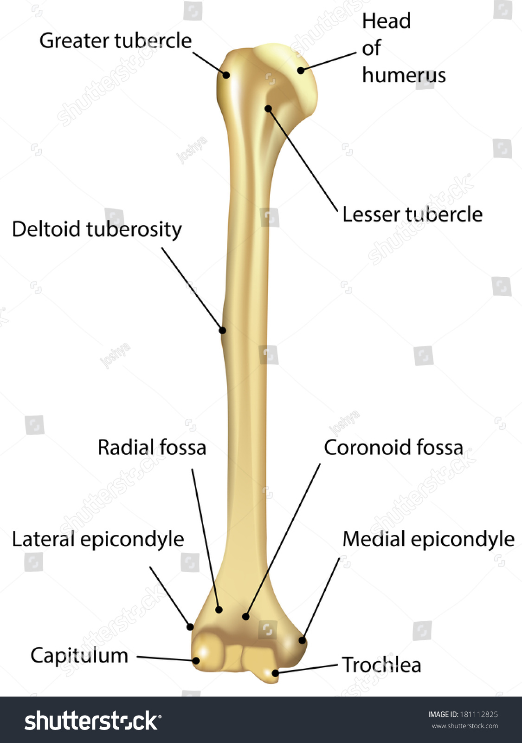

Slide 10
Radius and ulna
Are 2 bones of the forearm
Ulna is medial while radius is lateral.
Ulna is longer than radius
The two bones are parallel to each other.
They articulate at the elbow with humerus to form elbow joints
They articulate with carpal joint at the wrist to form wrist joint and with each other at the proximal and distal to form radial ulna joint

Slide 11
An interosseous membrane, a fibrous joint, connects the bones along their shafts, stabilising their association and maintaining their relative positions despite forces applied from the elbow or wrist.
Landmarks of ulna
Olecranon- A large projection of bone forming part of trochlear notch. It can be palpated at the tip of the elbow. The triceps brachii muscles attaches to its superior surface
Trochlear notch- formed by olecranon and coronoid process. It articulates with the trochlear of humerus

Slide 12
Coronoid process- this ridge of bone projects outwards anteriorly forming part of trochlear notch
Radial notch – located on lateral surface of trochlear notch, this area articulates with the head of the radius.
Tuberosity of ulna- A rough surface distal to coronoid process. It is where brachialis muscles attaches

Slide 13
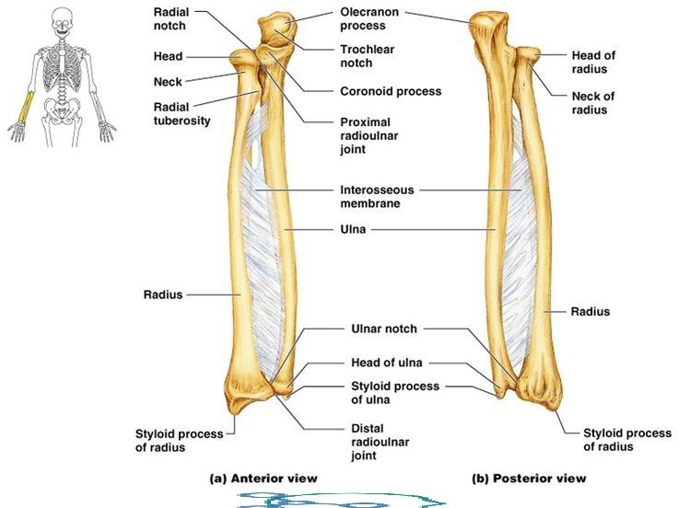

Slide 14
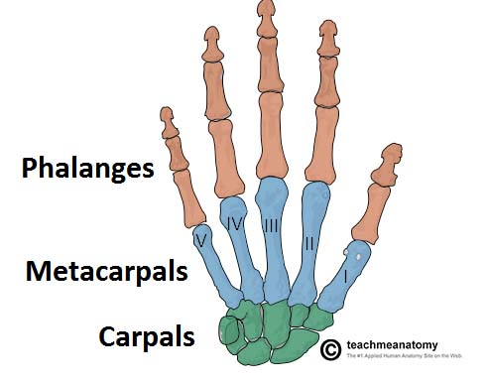
Wrist and handbones

Slide 15
Carpal or wrist bones
Are 8 irregularly shaped bones arranged in two rows i.e proximal and distal
Each row has 4 bones
These bones are held together by ligaments and allow a certain amount of movement
Those proximal form wrist joint also known as radio-carpal joint while those distal form joints with metacarpal to form metacarpal joints
From outside inwards they are:
Proximal row (lateral-medial) consists of : scaphoid, lunate, triquetrum, pisiform
Distal row (lateral-medial) consists of: trapezium, trapezoid, capitate, hamate.

Slide 16
Tendons of muscles lying in the forearm cross the wrist and are held close to the bones by strong fibrous bands, called retinacula

Slide 17
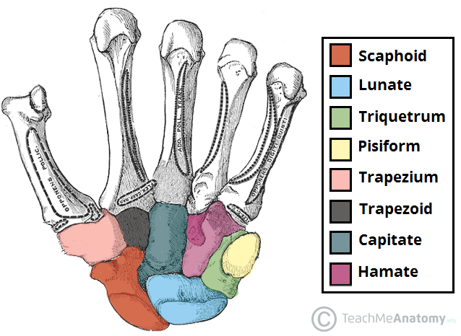

Slide 18
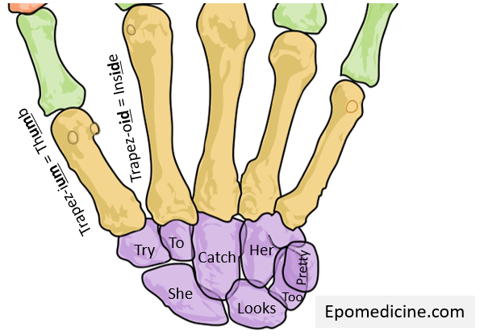

Slide 19
Metacarpal bones
These five bones form the palm of the hand.
The proximal ends articulate with the carpal bones and the distal ends with the phalanges.
They are numbered from the thumb side inwards and each metacarpal is associated with a digit
Metacarpal I –Thumb
Metacarpal II- Index finger
Metacarpal III- Middle finger
Metacarpal IV- Ring finger
Metacarpal V- Little finger

Slide 20
Phalanges (finger bones)
There are 14 phalanges, three in each finger and two in the thumb.
They articulate with the metacarpal bones and with each other, by hinge joints.
The thumb has distal and proximal phalanx while rest of digits have proximal, middle and distal phalanges,

Slide 21
Muscles of the upper extremities and shoulder
Muscles are involved in contraction and relaxation to allow movement of limbs
Upper extremities and shoulder are supplied with skeletal muscles are involved in voluntary movement
These muscles stabilise the association between the appendicular and axial skeletons at the pectoral girdle, and stabilise and allow movement of the shoulders and upper arms.

Slide 22
Muscles of shoulder girdle (anterior muscles)
1. pectoral region muscle
They are 4 in number and consists of pectoral major, pectoral minor, subclavius and serrateous anterior.
a.Pectoralis major
This lies on the anterior thoracic wall.
The fibres originate from the middle third of the clavicle and from the sternum and are inserted into the lip of the intertubercular groove of the humerus.
It draws the arm forward and towards the body, i.e. flexes and adducts.

Slide 23
b.Pectoralis minor
Lies underneath pectoralis major.
Form part of axilla region
Originates from 3rd -5th ribs and inserts into the coracoid process of scapula
Stabilises scapula by drawing it anterioinferiorly against thoracic wall

Slide 24
c.Serratus anterior
Is located more laterally in the chest wall and forms the medial border of the axilla region
They originate from lateral aspects of ribs 1-8.
They attach to costal (rib facing) surface of the medial border of the scapula
Rotates the scapula allowing the arm to be raised over 90 degrees.
Holds scapula against ribcage

Slide 25
d. Subclavius
Is a small muscle located underneath the clavical running horizontally
It gives protection to underlying neurovascular structures e.g in cases of clavicular fracture or other trauma
Originates from the junction of first rib and costal cartilage inserting to inferior surface of the middle third of clavicle
Anchors and depresses the clavicle

Slide 26
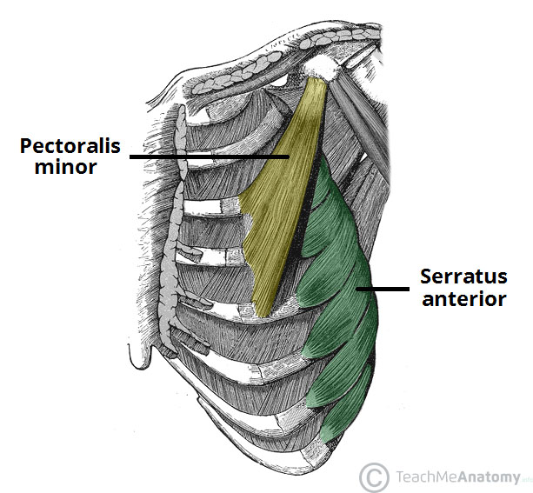

Slide 27
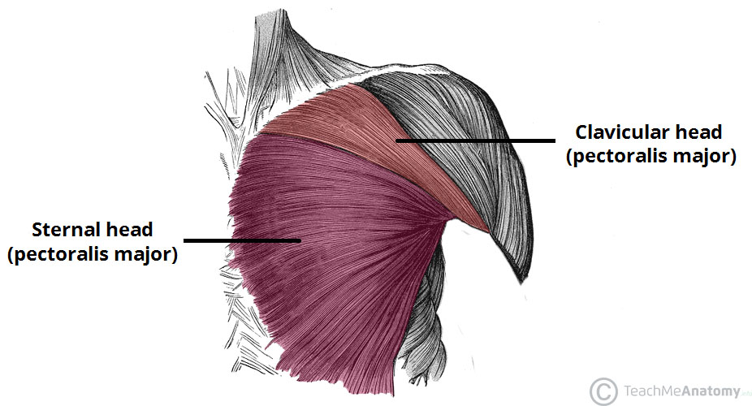

Slide 28
2.Posterior muscles
Scapula-humeral muscles (intrinsic muscles)
They originate from the scapula and or clavicle and attach to humerus
They 6 in number and inlcude
Deltoid
Teres major
Rotator cuff muscle-These rotator cuff muscles are 4 in number i.e supraspinatus, infraspinatus, teres minor and subcaspularis

Slide 29
a.Deltoid muscles
These muscle fibres originate from the lateral one third of clavicle, acromion process and spine of scapula and radiate over the shoulder joint to be inserted into the deltoid tuberosity of the humerus.
It forms the fleshy and rounded contour of the shoulder and the main function is movement of the arm.
Movements allowed: abduction of the arm, flexion and medial rotation of humerus

Slide 30
They also cause rythmic swinging movement of arm e.g during walking
b.Teres major
Originates from posterior surface of scapula adjacent to lateral border
It attaches to greater tubercle of humerus
Laterally rotates the arm

Slide 31
b.Rotator cuff muscles
Supraspinatus- originates from superior surface of spine of the scapula and inserts on superior aspect of greater tubercle of humerus. It stabilizes shoulder joint and prevents downward dislocation of humerus. Allows abduction of the arm

Slide 32
Infraspinatus- originates from infraspinous fossa of scapula and inserts in greater tubercle of humerus. It stabilises the shoulder joint and is involved lateral rotation of the humerus
Teres minor- Originate from posterior surface of scapula adjacent to its lateral border. It attaches to greater tubercle of the humerus
Subscapularis- originates from subscapular fossa on costal surface of scapula. It attaches to lesser tubercle of humerus. It is important in stabilizing the shoulder and in medial rotation of humerus

Slide 33
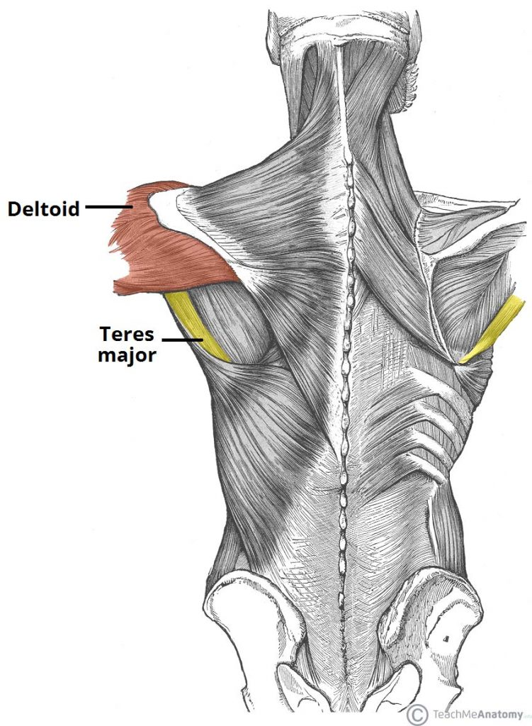
Instrinsic muscles/Scapula-humeral muscles

Slide 34
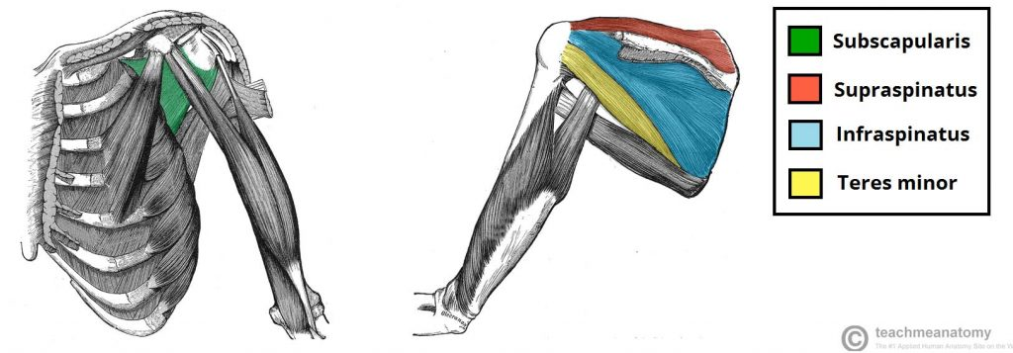
Intrinsic muscles (Rotator cuff muscles)

Slide 35
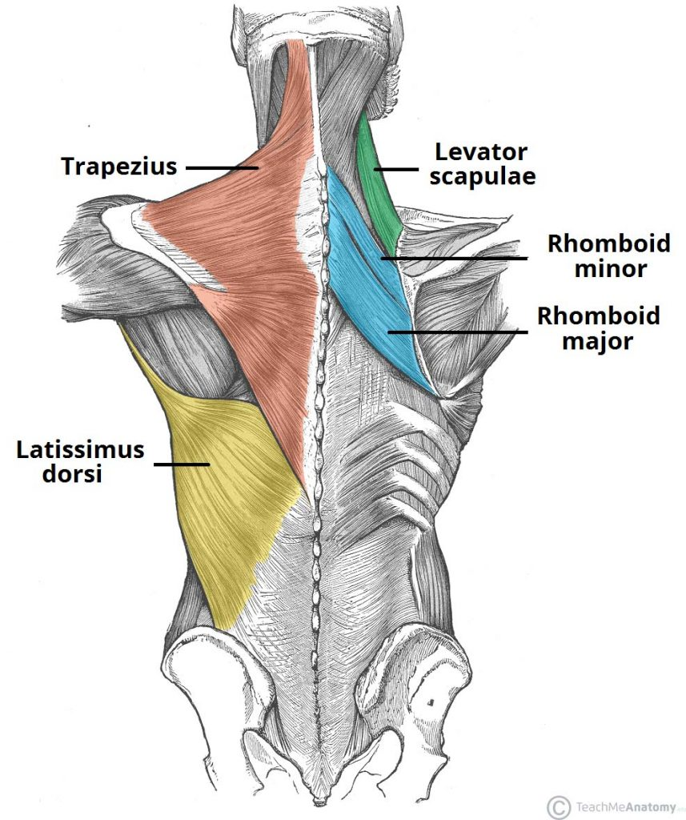
Extrinsic muscles (axial –appendicular muscles)

Slide 36
3. Axio-appendicular muscles (extrinsic muscles)
Connect axial skeleton to appendicular skeleton
They originate from torso (trunk) and attach to bones of shoulder (clavicle, scapula or humerus)
The muscles are both deep and superficial muscles
Superficial layer- trapezium and latissmus dorsi
Deep layer- levator scapula, rhomboid major and rhomboid minor

Slide 37
a.Trapezium-
is flat and triangular muscle. Is the most superficial of all back muscles. originates from the skull, nuchal ligament and spinous process 0f C7-T12.
The fibres attach to the clavicle, acromion and scapula spine.
Upper fibers rotates it during adduction of arm.
Middle fibres retract the scapula and lower fibres pull scapula inferiorly

Slide 38
b.Latissmus Dorsi
Is superficial and originates from lower thoracic vertebrae , the 3rd and 4th ribs, iliac crest and lumbar vertebrae
It inserts to intertubercular sulcus of humerus
It extends, adducts and medially rotates the upper limb

Slide 39
c.Levator scapula
It is a deep muscle
It begins in the neck and extends to to the scapula
Originates from transverse processes of C1-C4 vertebrae and attaches to medial border of scapula
It elevates the scapula

Slide 40
d. Rhomboids
Are deep muscles
There are 2 rhomboid muscles-major an minor
Rhomboid minor is located superiorly to major
Rhomboid major- originates from spinous processes of T2-T5 vertebrae. Attaches to medial border of scapula between scapula spine and inferior angle. It retracts and rotates scapula
Rhomboid minor-originates from spinous process of C7-T1. it attaches to medial border of scapula at the level of spine of scapula. It retracts and rotates scapula

Slide 41
Muscles of arm
It consists of 4 muscle
3 in anterior compartment (biceps brachii, brachialis, coracobrachialis and one in posterior compartment (triceps brachii)
.

Slide 42
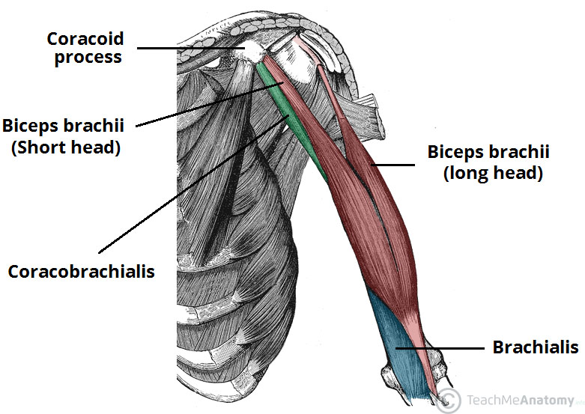
Muscles of arm : anterior compartment

Slide 43
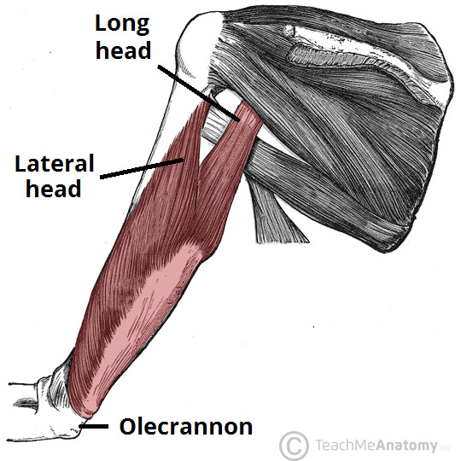
Muscles of posterior compartment of arm

Slide 44
Anterior compartment
It consists of
Coracobrachialis
This lies on the upper medial aspect of the arm.
It arises from the coracoid process of the scapula, stretches across in front of the shoulder joint and is inserted into the middle third of the humerus.
It flexes the shoulder joint

Slide 45
Biceps
This lies on the anterior aspect of the upper arm.
At its proximal end it is divided into two parts (heads), each of which has its own tendon.
The short head rises from the coracoid process of the scapula and passes in front of the shoulder joint to the arm.
The long head originates from the rim of the glenoid cavity and its tendon passes through the joint cavity and the bicipital groove of the humerus to the arm.
It is retained in the bicipital groove by a transverse humeral ligament that stretches across the groove.
The distal tendon crosses the elbow joint and is inserted into the radial tuberosity.
It helps to stabilise and flex the shoulder joint and at the elbow joint it assists with flexion and supination.

Slide 46
Brachialis
This lies on the anterior aspect of the upper arm deep to the biceps.
It originates from the shaft of the humerus, extends across the elbow joint and is inserted into the ulna just distal to the joint capsule.
It is the main flexor of the elbow joint.

Slide 47
Posterior compartment of arm
It contains of triceps brachii muscles which has 3 heads-medial, lateral
Triceps brachii
Originates from infraglenoid tubercle
Lateral head originates from humerus superior to radial groove.
Medial head from humerus inferior to the radial groove
Distally, the head converge onto one tendon and insert into the olecranon process of the ulna.
It helps to stabilise the shoulder joint
Assists in adduction of the arm and extends the elbow joint.

Slide 48
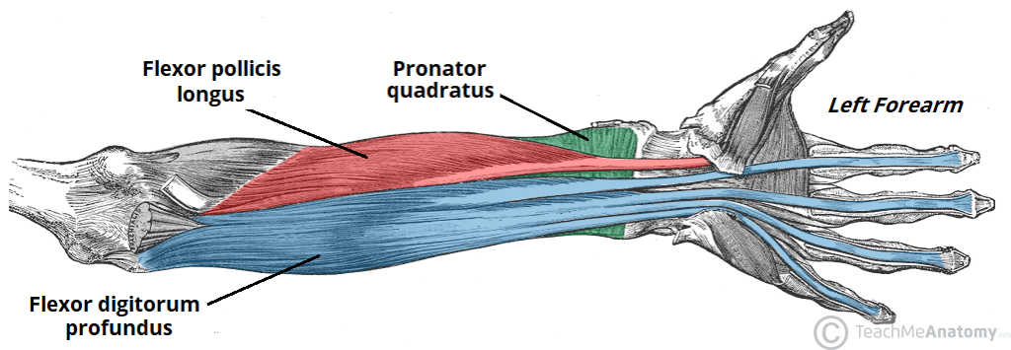
Muscles of forearm Deep muscles of anterior compartment of forearm

Slide 49
Muscles in forearm
Anterior compartment
The anterior compartment consists of muscles that perform flexion at the wrist and fingers and pronation. These muscles are both deep and superficial muscles
Deep muscles
1.Pronator quadratus
This square-shaped muscle is the main muscle causing pronation of the hand and has attachments on the lower sections of both the radius and the ulna.

Slide 50
2.Flexor pollicus longus
Originate from anterior surface of shaft of radius
Insert into distal phalanx of the thumb
They flex distal phalanx of the thumb
3.Flexor digitorum profundus
Originate from anteromedial surface of shaft of ulna
Insert to distal phalanges of medial four fingers

Slide 51
Flexes distal phalanx of fingers then assist in flexion of middle and proximal phalanges and wrist

Slide 52
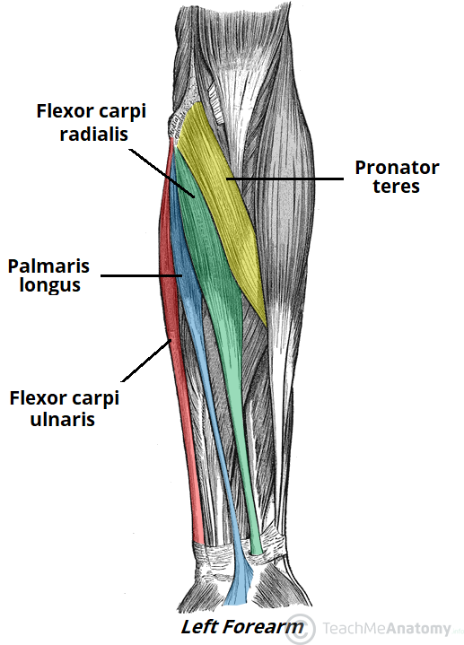
Superficial muscles of anterior compartment of forearm

Slide 53
Superficial layer of forearm consists of
1.Pronator teres
This lies obliquely across the upper third of the front of the forearm.
It arises from the medial epicondyle of the humerus and the coronoid process of the ulna and passes obliquely across the forearm to be inserted into the lateral surface of the shaft of the radius.
It rotates the radioulnar joints, changing the hand from the anatomical to the writing position, i.e. pronation.

Slide 54
2.Flexor carpi radialis
This lies on the anterior surface of the forearm. It originates from the medial epicondyle of the humerus and is inserted into the second and third metacarpal bones.
It flexes the wrist joint, and when acting with the extensor carpi radialis, abducts the joint.

Slide 55
3.Flexor carpi ulnaris
This lies on the medial aspect of the forearm. It originates from the medial epicondyle of the humerus and the upper parts of the ulna and is inserted into the pisiform, the hamate and the fifth metacarpal bones.
It flexes the wrist, and when acting with the extensor carpi ulnaris, adducts the joint.

Slide 56
4.Palmaris longus
This muscle resists shearing forces that might pull the skin and fascia of the palm away from the underlying structures, and flexes the wrist.
Its origin is on the medial epicondyle of the humerus, and it inserts on tendons on the palm of the hand

Slide 57
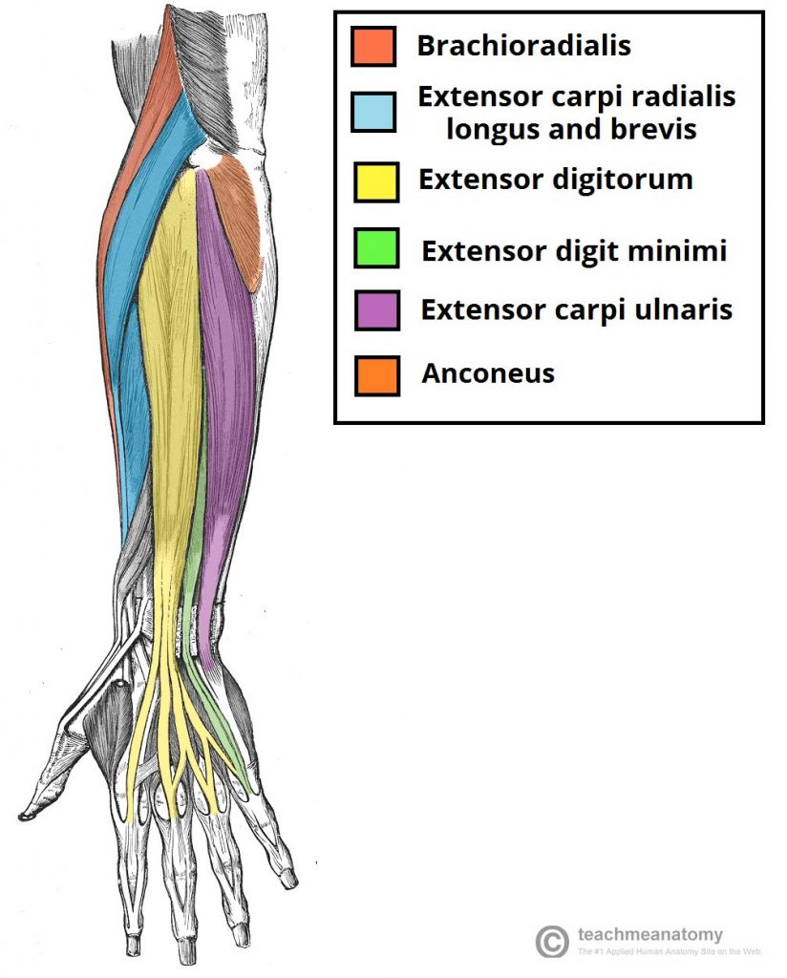
Muscles in superficial layer of posterior forearm

Slide 58
Muscles in posterior compartment of forearm
They produce extension of wrist and fingers
They include;
Superficial layer
1.Extensor carpi radialis longus and brevis
These lie on the posterior aspect of the forearm.
The fibres originate from the lateral epicondyle of the humerus and are inserted by a long tendon into the second and third metacarpal bones.
They extend and abduct the wrist

Slide 59
2.Extensor carpi ulnaris
This lies on the posterior surface of the forearm.
It originates from the lateral epicondyle of the humerus and is inserted into the fifth metacarpal bone.
It extends and adducts the wrist

Slide 60
3.Extensor digitorum
This muscle originates on the lateral epicondyle of the humerus and spans both the elbow and wrist joints; in the wrist, it divides into four tendons, one for each finger.
Action of this muscle can extend any of the joints across which it passes, i.e. the elbow, wrist or finger joints.

Slide 61
4.Anconeus
Originates from lateral epicondyle of humerus and attaches to posterior and lateral part of olecranon of ulna
Extends and stabilises the elbow joint
Abducts the ulna during pronation of forearm
5.Brachioradialis
originate from lateral supracondylar ridge (epicondyle) of humerus
Inserts on base of styloid process of radius
Flexes forearm and stabilises the elbow joint

Slide 62
6. Extensor muscles minimi
Originates from lateral epicondyle of humerus
Inserts at extensor expansion of little finger
Extends metacarpal phalangeal joint of little finger

Slide 63
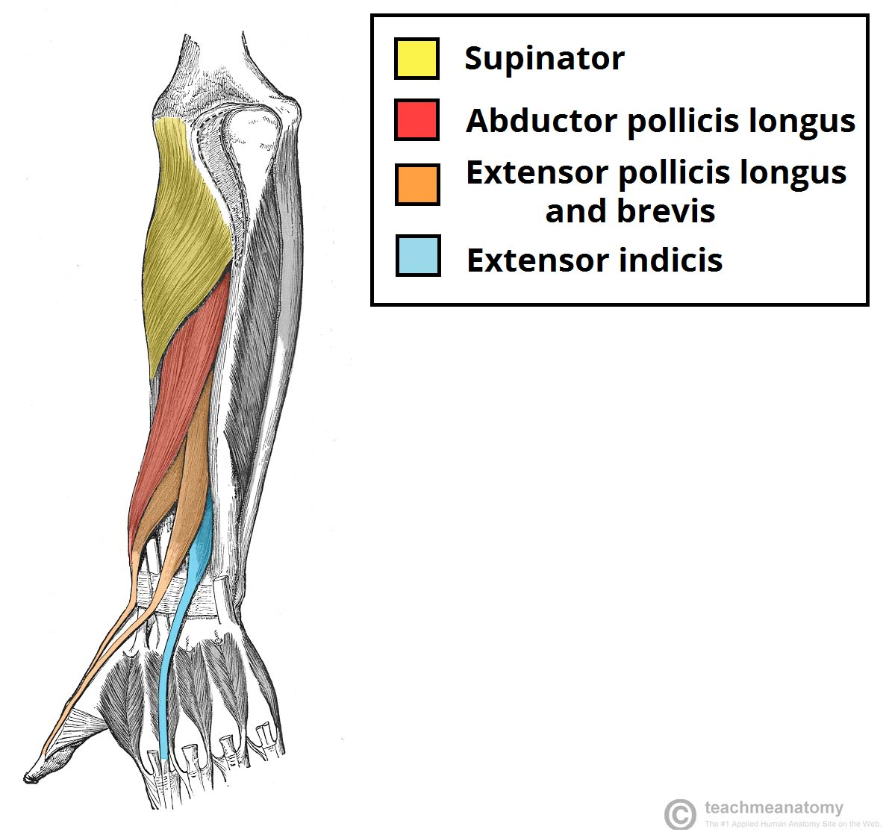
Muscles in deep layer of posterior forearm

Slide 64
Deep muscles
1.Supinator
Is a deep muscle and lies obliquely across the posterior and lateral aspects of the forearm.
Its fibres arise from the lateral epicondyle of the humerus and the upper part of the ulna and are inserted into the lateral surface of the upper third of the radius.
It rotates the radio-ulnar joints, often with help from the biceps, changing the hand from the writing to the anatomical position, i.e. supination

Slide 65
Extensor pollicis brevis
Originates from posterior surface of shaft of radius
Inserts at the base of proximal phalanx of the thumb
Extends metacarpophalangeal joints of thumb
Extensor pollicics longus
Originates from posterior surface middle 1/3 of shaft of ulna
Inserts at the base of distal phalanx of thumb
Extends the metacarpophalangeal thumb

Slide 66
Extensor indicis
Originate from posterior surface of shaft of distal ulna
Inserts at index finger (second finger)
Extends index finger

